Slide 1

New Member Orientation
Kharghar Toastmasters Club
2024 - 2025

Slide 2
Agenda
What is Toastmasters
About District 98
Kharghar Toastmasters Club
Anatomy of club
Educational Program
Membership fees
How we connect
Few important Ask
Question

Slide 3
About Myself
Name : Amit Sharma
Role in the Club : Vice President Education of Kharghar Toastmasters Club
Member of Toastmasters since 2022
Past roles : Have been the VP-PR for year 2022-2023
Professional details: A Telecom professional and A Coach
Educational: B.Tech & Certified Coach from ICF
Why are continuing: To Become a transformational speaker.

Slide 4
Toastmasters
Formed : 1924
Founder : Dr Ralph Smedley
Clubs : 17000+
Countries : 150+
Members : 4Lakhs+
District : 123+
The mission of a Toastmasters club is to provide a mutually supportive and positive learning environment in which every individual member has the opportunity to develop oral communication and leadership skills, which in turn foster self-confidence and personal growth.

Slide 5
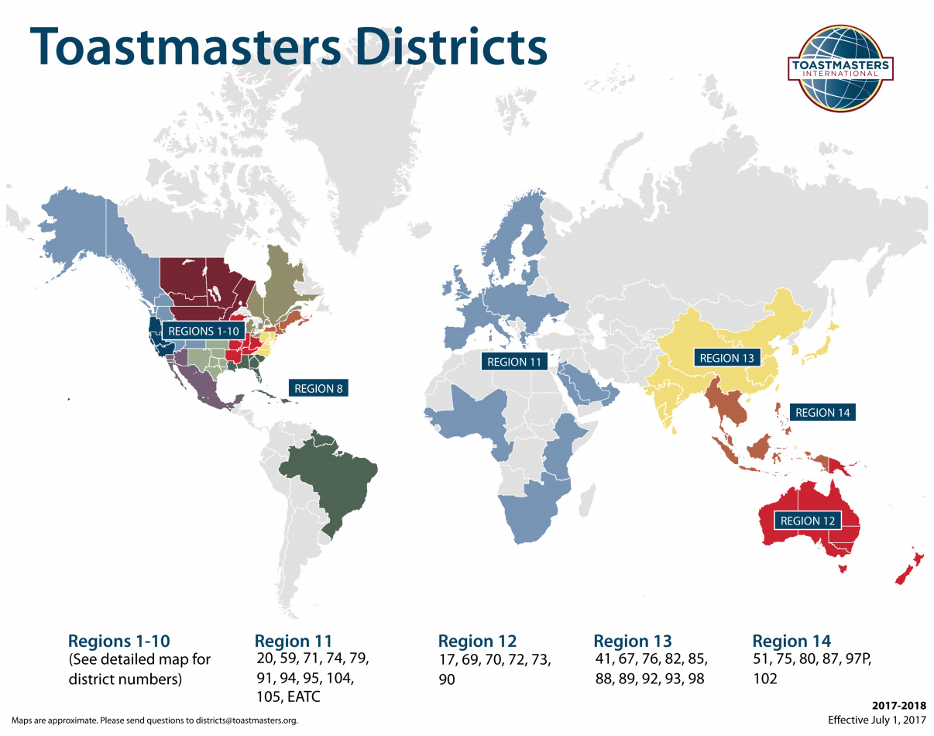
Toastmasters Regions

Slide 6
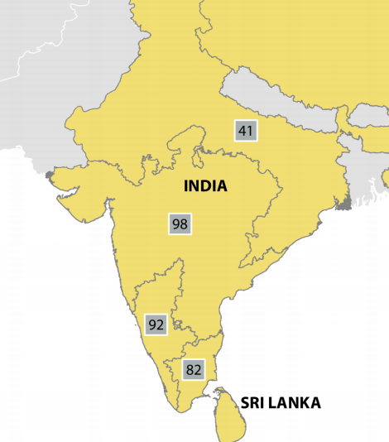
District 98

Slide 7
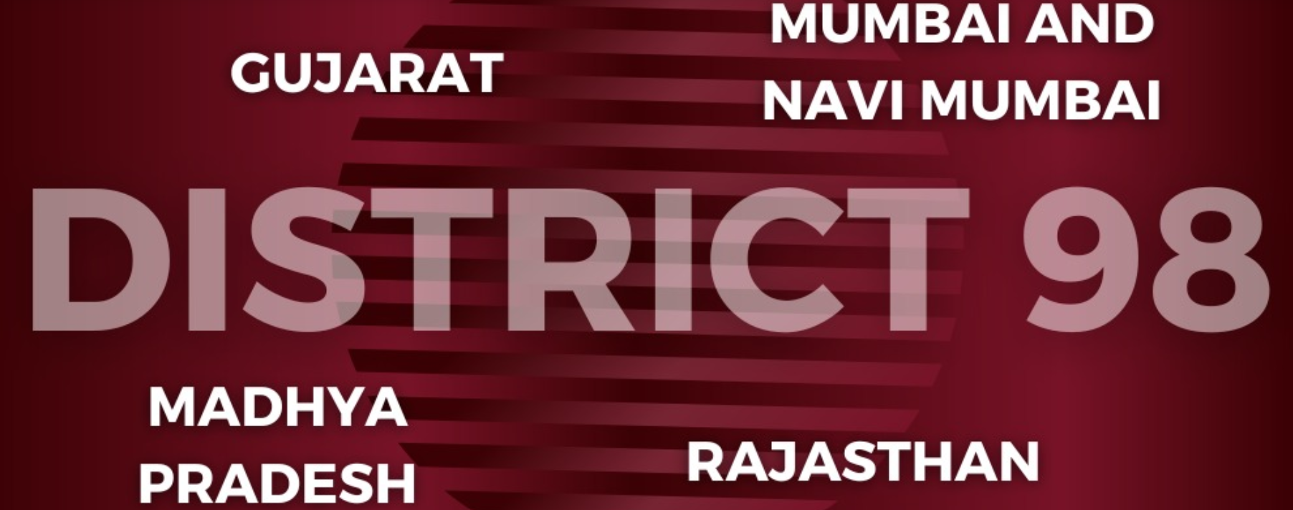

Slide 8
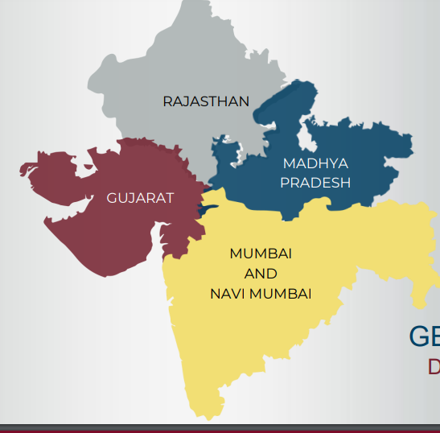

Slide 9
How big is our District?
District 98 encompasses Gujarat, Mumbai, Navi Mumbai, Madhya Pradesh and Rajasthan
This District is among the fastest growing Districts in the world! https://www.district98.org/

Slide 10
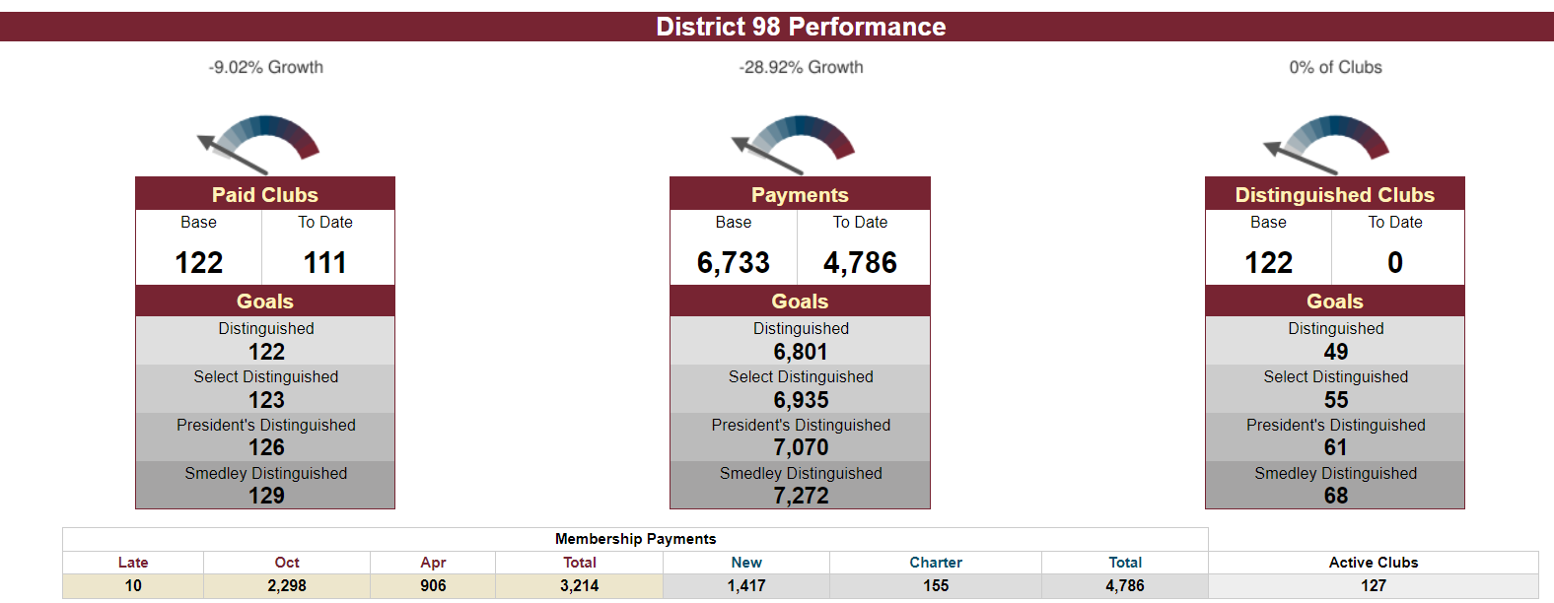
D98 Performance so far as on February 2024

Slide 11
About Kharghar Toastmasters Club
Formed : January 2019
Past President : Rohan Parakh, Anantha Iyer, Abhijit Roy, DTM, Chidanand Pradhan, DTM, Syam S.
Current President : Ajay Kale.
Club members participated in all district initiative and have won the highest award Diamond club award twice.
Area : M2
Area Director : Arun Pandey/Sameer Throat /Amit Sharma (AAD)
Division Director : Aanand
District Trio : Sunita Vinod, Hardik Shah & Joydeep.

Slide 12
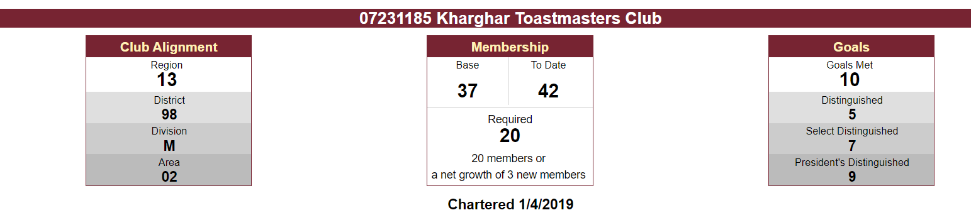
Club Performance this year – Feb 2024

Slide 13
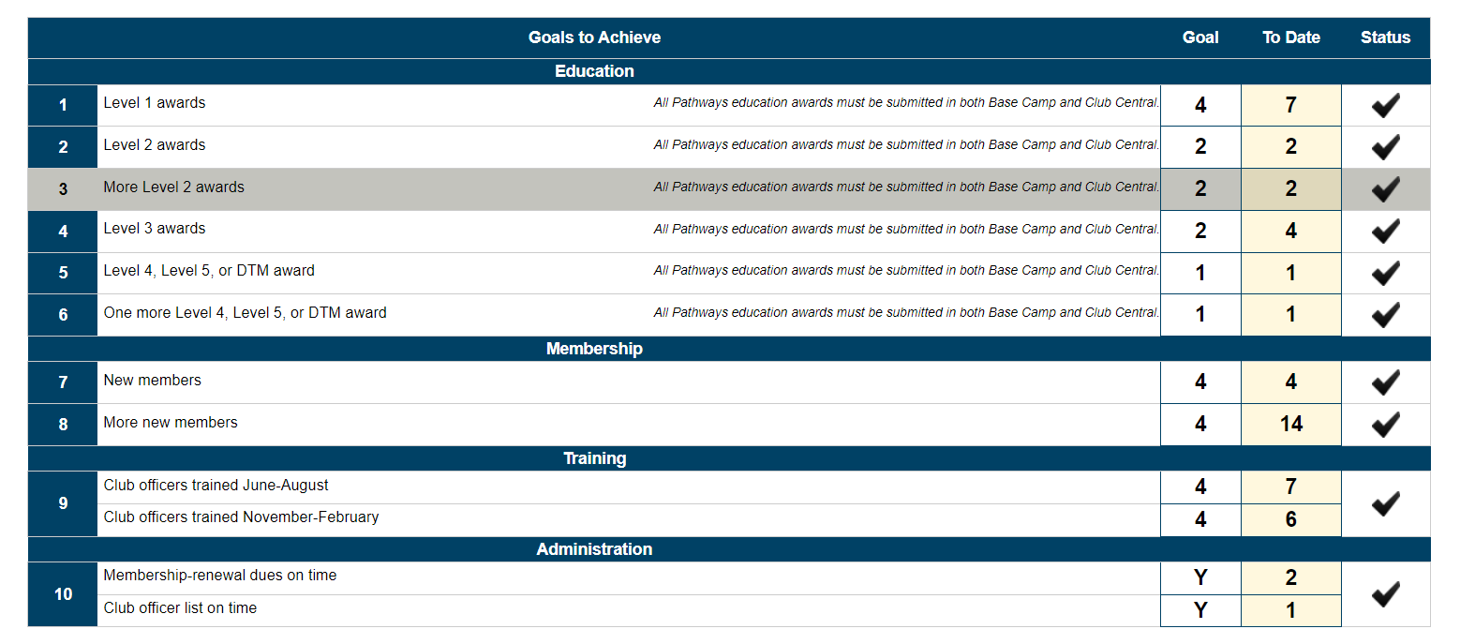
Club Performance this year – Feb 2024

Slide 14
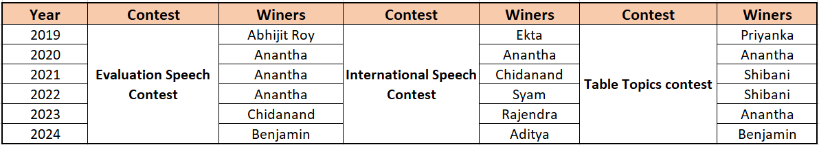

Winner From Club
For Year - 2024
ESC: First place winner from club and area contest was Benjamin
ISC: Yet to decide.

Slide 15
Benefits
Clearer communication
Improved leadership skills
Enhanced teamwork
Effective meetings
Increased productivity
Positive mentoring
Cost effective

Slide 16
Types of Club
Community
Corporate
College
Government agency
Religious
Online
Gavels Club (Children)

Slide 17
Organization Structure
Club
Club
Area
Area M2
Division
Division M
District
District 98
Region
Region 13
Board of Directors of Toastmasters
International
International

Slide 18
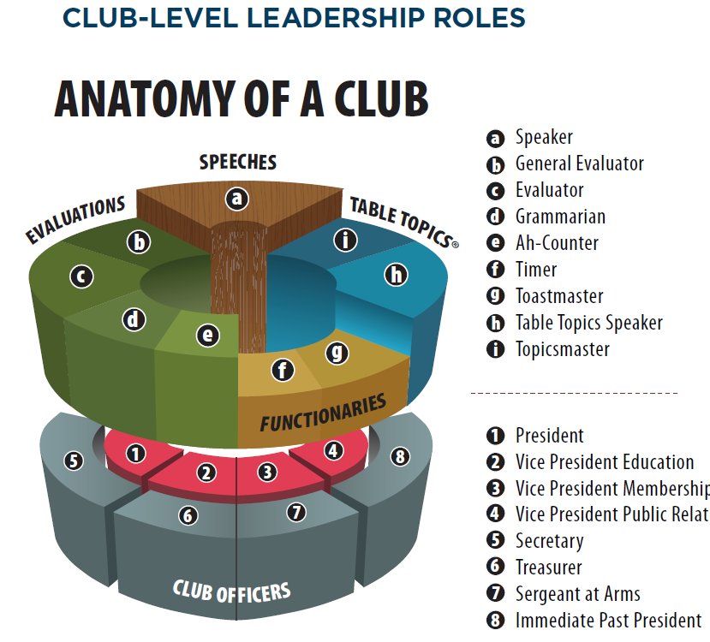

Slide 19
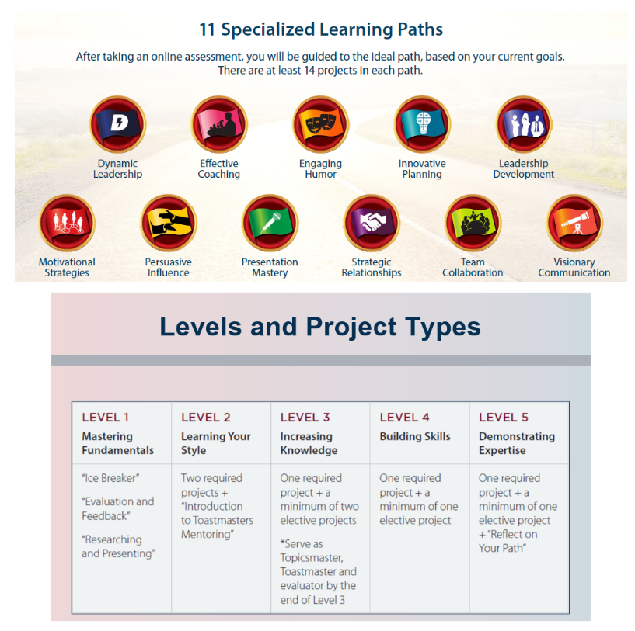
Educational Program - Pathways

Slide 20
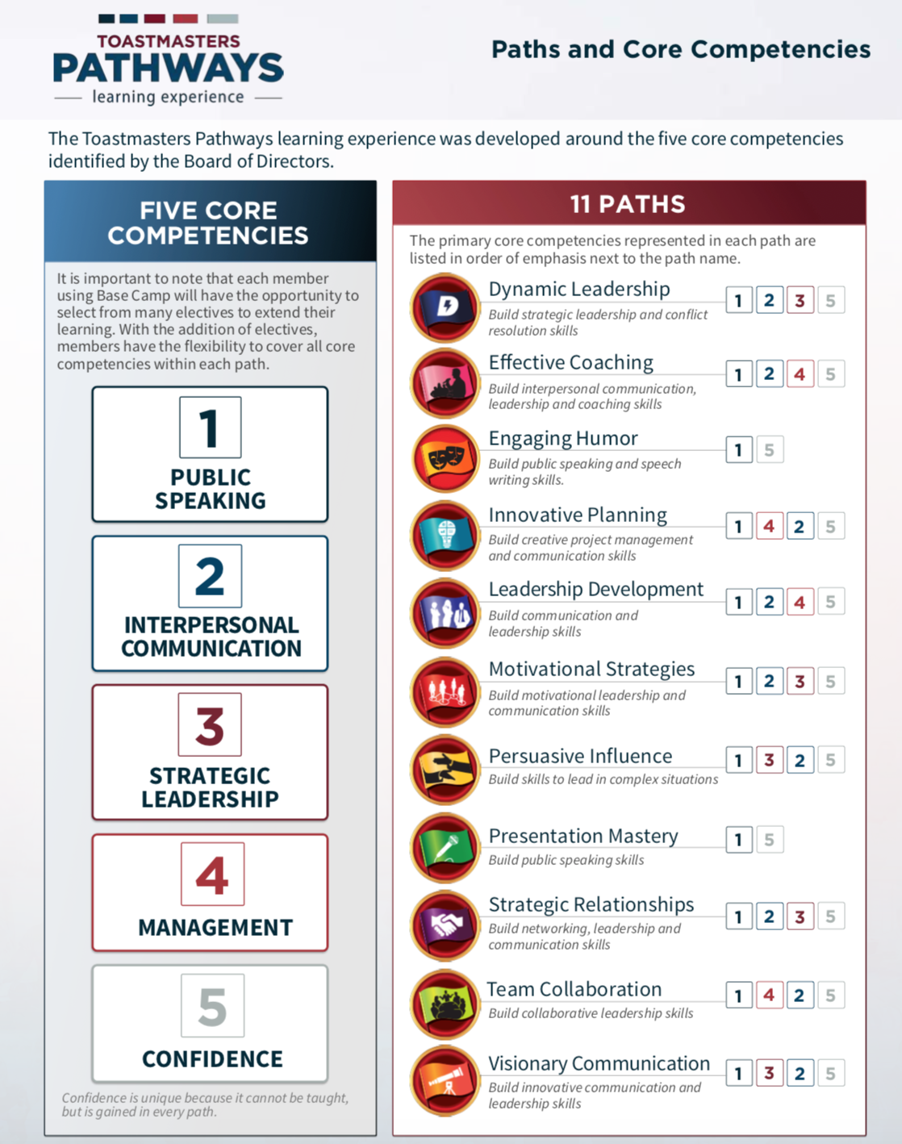
More on Pathways

Slide 21
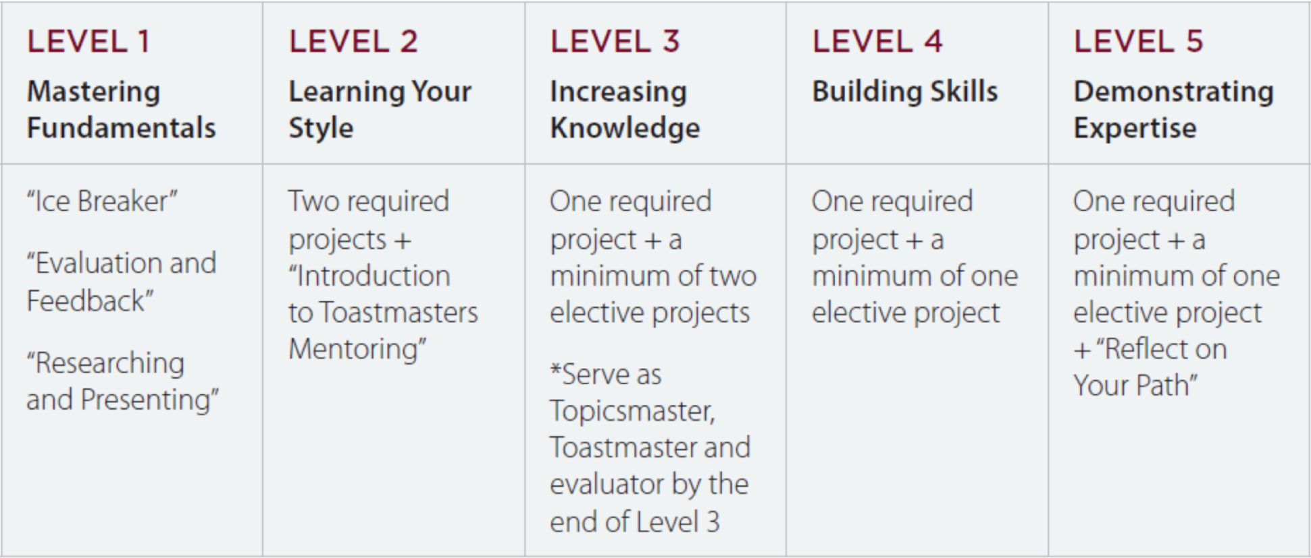
Levels and Project Types

Slide 22







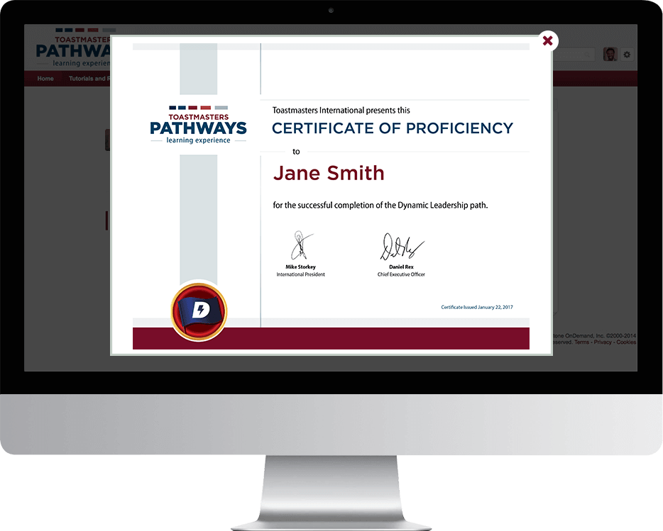


Badges and Awards

Slide 23
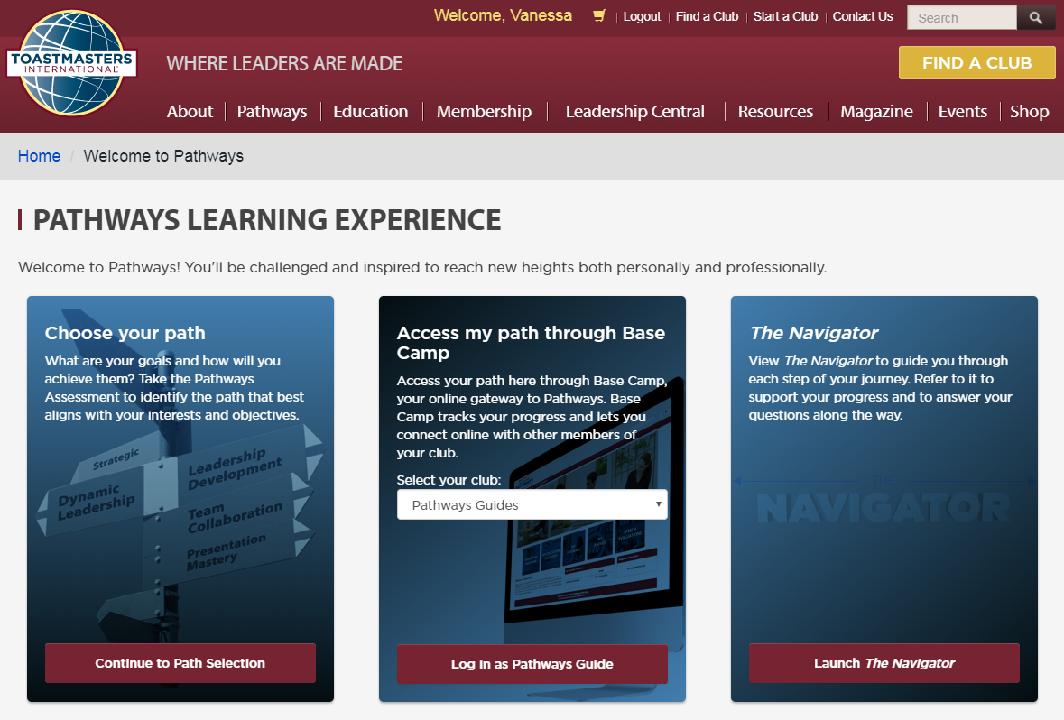
Getting Started

Slide 24

Your Guide to Pathways

Slide 25
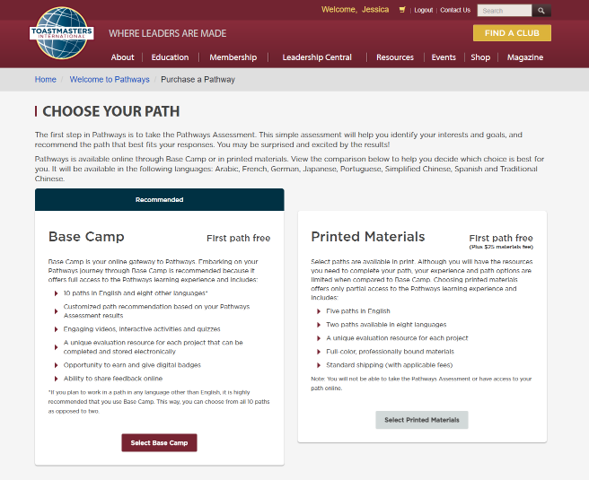
Online or Print

Slide 26
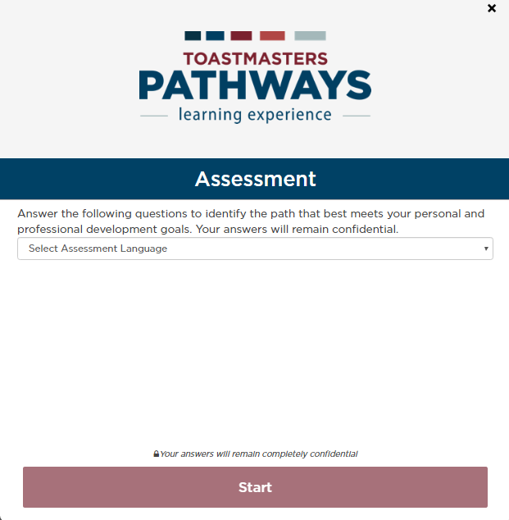

Slide 27
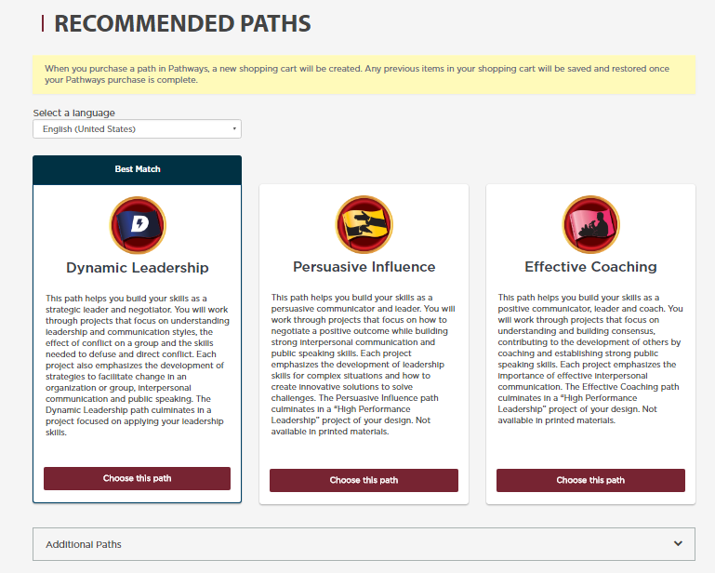

Slide 28
How we Connect ?
Meeting : 2nd and 4th Saturday from 03 to 06 PM
Physical Location : VISHWAJYOT HIGH SCHOOL SECTOR-20, KHARGHAR
Hybrid Location : VISHWAJYOT HIGH SCHOOL SECTOR-20, KHARGHAR
Role player Nomination : Through Whatsapp
Membership fees : Rs. 6600/- (6 months)
One time Registration fee : Rs.1800/-
Reach out to Ajay Kale or Aravind Krishna

Slide 29
Few important Ask ?
Connect with Mentorship Chair – DTM Ayush Mishra
Get your self a mentor – Reach out to Mentorship Chair
Reach out to Mentor – Member responsibility.
Choose your Path : Speak With Amit Sharma
Roadmap for next few months : Speak with Assigned Mentor
Will assign you mentor, periodically review your progress
Organize the meeting on first Sunday of every month to get the feedback from TMs
Pathways Selection Chair: TM Amit

Slide 30
Our Digital Presence
Facebook
Twitter
Linkedin
Whatsapp

Slide 31
Leadership Team
President : Ajay Kale.
VP – Education : Amit Sharma
VP – Membership : Aravind Krishna
VP – Public Relations : Vishal Kulkarni—Resigned..
Secretary : Aditya Shinde
Treasurer : Ravindera Deskhmukh
Sergeant-at-Arms : TM Somnath
Immediate Past President : Syam S

Slide 32


